Slide 1


Correlation and Regression Analysis
Twinkle Patel
Dataset: Health Behavior in School-Aged Children

Slide 2

Purpose of Regression Analysis
The primary purpose of regression analysis is to examine the relationship between a dependent variable and one or more independent variables.

Slide 3

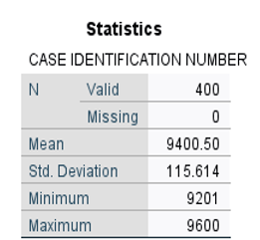



Data Selection

Slide 4

 | LIFE SATISFACTION SCALE | GRADE IN SCHOOL | FAMILY WELL OFF | NUMBER OF COMPUTERS FAMILY OWNS | FAMILY AFFLUENCE SCALE - COMPUTED | HOURS WATCH TELEVISION, WEEKDAYS | HOURS WATCH TELEVISION, WEEKEND | NUMBER OF DAYS PHYSICALLY ACTIVE PAST WEEK | HOW OFTEN EAT BREAKFAST, WEEKDAYS | HOW OFTEN EAT BREAKFAST W/ PARENT(S) | HOW OFTEN GO TO SCHOOL / BED HUNGRY | FEELINGS ABOUT BODY: FRUSTRATED W/ APPEARANCE | FEELINGS ABOUT BODY: SATISFIED W/ APPEARANCE | PAST 6 MONTHS HOW OFTEN HAD: FEELING LOW | PAST 6 MONTHS HOW OFTEN HAD: FEELING DIZZY | PAST MONTH TAKEN MEDICINE FOR: DIFFICULTIES SLEEPING | OVERALL HEALTH RATING
LIFE SATISFACTION SCALE | 1 | -0.091 | -.316** | 0.084 | .144** | -0.048 | -0.022 | .158** | .183** | .274** | .272** | -.249** | .142** | .386** | .164** | -0.054 | -.287**
GRADE IN SCHOOL | -0.091 | 1 | -0.005 | 0.068 | 0.021 | 0.011 | 0.023 | 0.085 | -.153** | -.154* | 0.092 | .140** | -0.033 | -.117* | 0.027 | 0.007 | .118*
FAMILY WELL OFF | -.316** | -0.005 | 1 | -.157** | -.211** | 0.075 | -0.024 | -0.055 | -0.059 | -.198** | -.104* | .139** | -.145** | -.120* | -.117* | 0.026 | .260**
NUMBER OF COMPUTERS FAMILY OWNS | 0.084 | 0.068 | -.157** | 1 | .698** | -.134** | -0.082 | .102* | 0.085 | 0.091 | 0.068 | 0.021 | 0.043 | -0.010 | 0.026 | 0.100 | -0.051
FAMILY AFFLUENCE SCALE – COMPUTED | .144** | 0.021 | -.211** | .698** | 1 | -.179** | -.122* | .172** | .200** | .230** | 0.062 | -0.062 | .113* | 0.049 | 0.082 | .102* | -.135**
HOURS WATCH TELEVISION, WEEKDAYS | -0.048 | 0.011 | 0.075 | -.134** | -.179** | 1 | .692** | -.136** | -.159** | -0.034 | 0.052 | 0.068 | -0.048 | -0.041 | -0.040 | -0.024 | 0.055
HOURS WATCH TELEVISION, WEEKEND | -0.022 | 0.023 | -0.024 | -0.082 | -.122* | .692** | 1 | -.134** | -.105* | -0.075 | 0.022 | 0.088 | -0.027 | -0.031 | -0.030 | -0.051 | 0.043
NUMBER OF DAYS PHYSICALLY ACTIVE PAST WEEK | .158** | 0.085 | -0.055 | .102* | .172** | -.136** | -.134** | 1 | 0.098 | 0.075 | 0.074 | -.170** | .137** | -0.057 | -0.057 | 0.046 | -.204**
HOW OFTEN EAT BREAKFAST, WEEKDAYS | .183** | -.153** | -0.059 | 0.085 | .200** | -.159** | -.105* | 0.098 | 1 | .272** | .172** | -.208** | .175** | .104* | 0.070 | -.104* | -.164**
HOW OFTEN EAT BREAKFAST W/ PARENT(S) | .274** | -.154* | -.198** | 0.091 | .230** | -0.034 | -0.075 | 0.075 | .272** | 1 | .151* | -.167** | 0.101 | .268** | 0.084 | 0.042 | -.206**
HOW OFTEN GO TO SCHOOL / BED HUNGRY | .272** | 0.092 | -.104* | 0.068 | 0.062 | 0.052 | 0.022 | 0.074 | .172** | .151* | 1 | -0.075 | 0.031 | .199** | .129* | -0.076 | -0.048
FEELINGS ABOUT BODY: FRUSTRATED W/ APPEARANCE | -.249** | .140** | .139** | 0.021 | -0.062 | 0.068 | 0.088 | -.170** | -.208** | -.167** | -0.075 | 1 | -.560** | -.310** | -.124* | 0.038 | .358**
FEELINGS ABOUT BODY: SATISFIED W/ APPEARANCE | .142** | -0.033 | -.145** | 0.043 | .113* | -0.048 | -0.027 | .137** | .175** | 0.101 | 0.031 | -.560** | 1 | .214** | 0.100 | -0.096 | -.295**
PAST 6 MONTHS HOW OFTEN HAD: FEELING LOW | .386** | -.117* | -.120* | -0.010 | 0.049 | -0.041 | -0.031 | -0.057 | .104* | .268** | .199** | -.310** | .214** | 1 | .425** | -0.082 | -.246**
PAST 6 MONTHS HOW OFTEN HAD: FEELING DIZZY | .164** | 0.027 | -.117* | 0.026 | 0.082 | -0.040 | -0.030 | -0.057 | 0.070 | 0.084 | .129* | -.124* | 0.100 | .425** | 1 | -.170** | -.152**
PAST MONTH TAKEN MEDICINE FOR: DIFFICULTIES SLEEPING | -0.054 | 0.007 | 0.026 | 0.100 | .102* | -0.024 | -0.051 | 0.046 | -.104* | 0.042 | -0.076 | 0.038 | -0.096 | -0.082 | -.170** | 1 | 0.012
OVERALL HEALTH RATING | -.287** | .118* | .260** | -0.051 | -.135** | 0.055 | 0.043 | -.204** | -.164** | -.206** | -0.048 | .358** | -.295** | -.246** | -.152** | 0.012 | 1
Correlations
Dependent

Slide 5


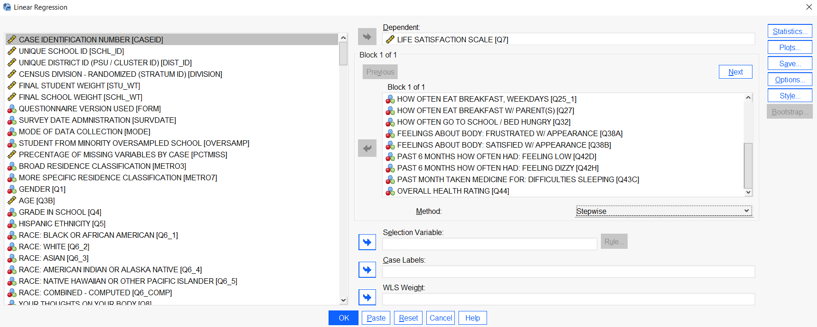

Choices Made for Regression Analysis
16 Independent

Slide 6

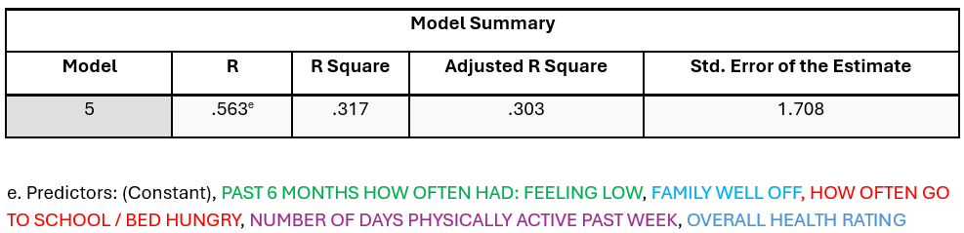

Regression Analysis Dependent Variable: Life Satisfaction Scale
Adjusted R Square = .303
The Adjusted R Square value of 0.303 indicates that this regression analysis explains about 30.3% of the variance in the dependent variable, Life Satisfaction Scale

Slide 7

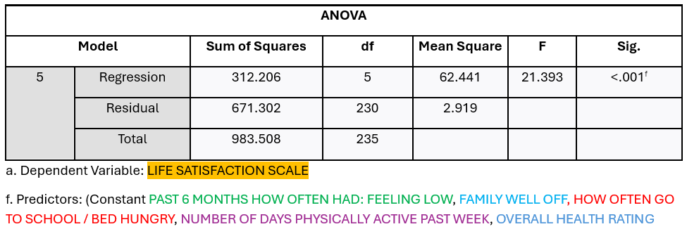


Regression Analysis Dependent Variable: Life Satisfaction Scale
The ANOVA table demonstrates that the regression model is statistically significant, with a p-value < 0.001, indicating a linear relationship between the variables.

Slide 8
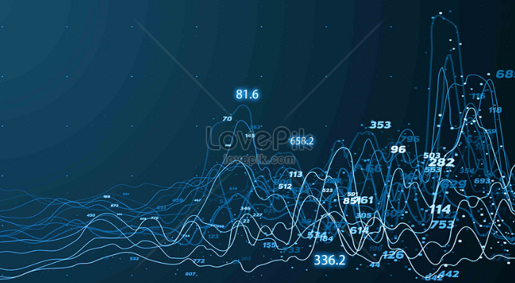
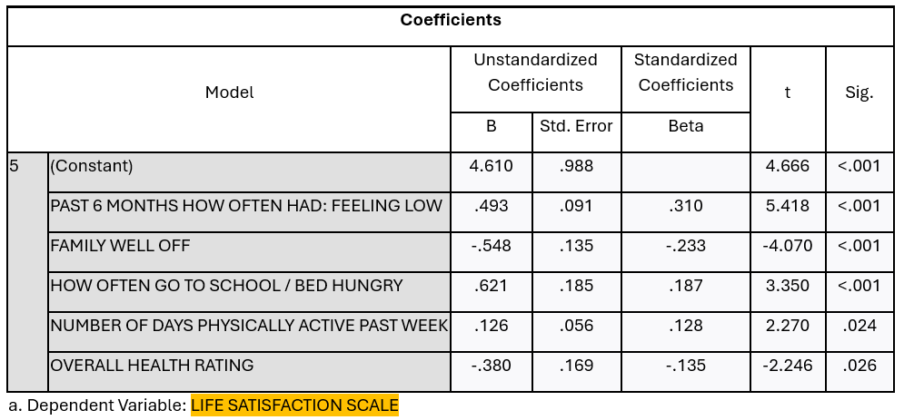
Regression Analysis Result Dependent Variable: Life Satisfaction Scale
Sig of <0.05 indicates that the variables are significant
This equation means that if we input a student’s values for each variable and multiply them by the corresponding coefficients, we can calculate an estimated score on the Life Satisfaction Scale.
Life Satisfaction Scale = 0.310 * Past 6 Months How Often Had: Feeling Low
- 0.233 * Family Well Off
+ 0.187 * How Often Go To School/Bed Hungry
- 0.135 * Overall Health Rating
+ 0.056 * Number Of Days Physically Active Past Week

Slide 9
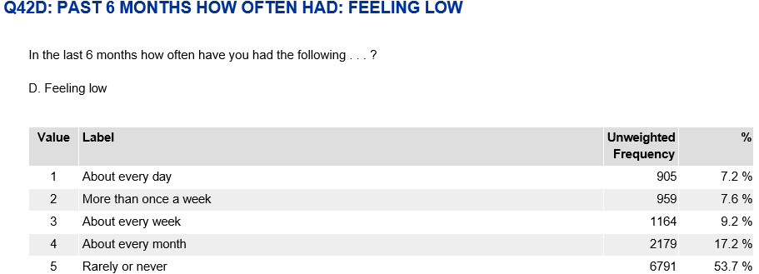
Life Satisfaction Scale = 0.310 * Past 6 Months How Often Had: Feeling Low
- 0.233 * Family Well Off
+ 0.187 * How Often Go To School/Bed Hungry
- 0.135 * Overall Health Rating
+ 0.056 * Number Of Days Physically Active Past Week

Slide 10
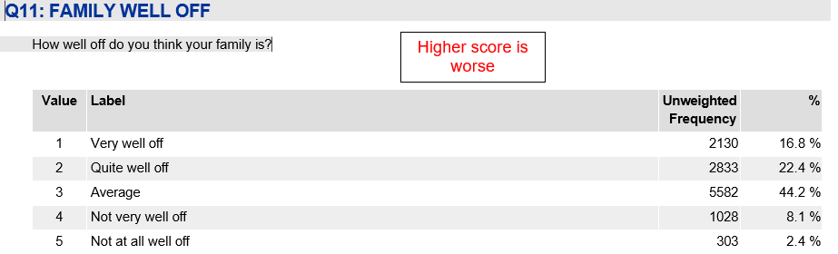
Life Satisfaction Scale = 0.310 * Past 6 Months How Often Had: Feeling Low
- 0.233 * Family Well Off
+ 0.187 * How Often Go To School/Bed Hungry
- 0.135 * Overall Health Rating
+ 0.056 * Number Of Days Physically Active Past Week
Reverse coding

Slide 11
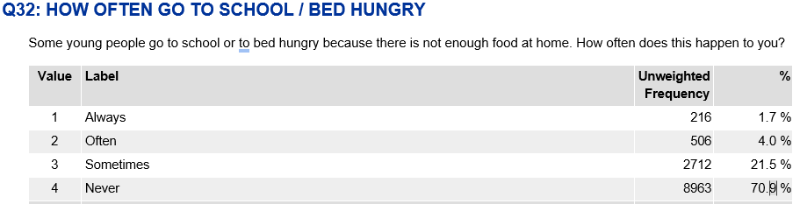
Life Satisfaction Scale = 0.310 * Past 6 Months How Often Had: Feeling Low
- 0.233 * Family Well Off
+ 0.187 * How Often Go To School/Bed Hungry
- 0.135 * Overall Health Rating
+ 0.056 * Number Of Days Physically Active Past Week

Slide 12
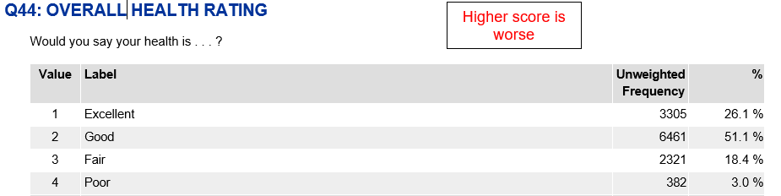
Life Satisfaction Scale = 0.310 * Past 6 Months How Often Had: Feeling Low
- 0.233 * Family Well Off
+ 0.187 * How Often Go To School/Bed Hungry
- 0.135 * Overall Health Rating
+ 0.056 * Number Of Days Physically Active Past Week
Reverse coding

Slide 13
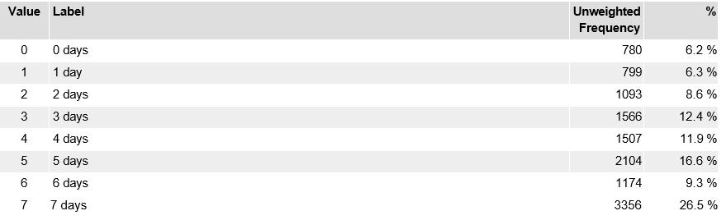
Life Satisfaction Scale = 0.310 * Past 6 Months How Often Had: Feeling Low
- 0.233 * Family Well Off
+ 0.187 * How Often Go To School/Bed Hungry
- 0.135 * Overall Health Rating
+ 0.056 * Number Of Days Physically Active Past Week
Reverse coding

Slide 14

Managerial Implications
Investing in key areas like food security, financial aid, physical activity, health education, and family engagement can improve students' daily lives.
By responding to these needs, institutions not only improve student life satisfaction but also contribute to better academic and personal outcomes.

Slide 15

Thank you!

